Slide 1
Questions
What are the functions of ASM?
What are three types of SUA?
Why is airspace classified?
What are the blocks of airspace for commercial flights?
What ATC units are responsible for these blocks of airspace?
Should Chinese airspace be “reclassified”?

Slide 2
Functions of ASM
collection and evaluation of all requests which require temporary airspace allocation;
planning and allocation of the required airspace to the users concerned where segregation is necessary;
activation or de-activation of such airspace within adequately narrow time tolerances, in close co-operation with ATC units and civil or military units concerned.
dissemination of detailed information, both in advance and in real time, to all parties concerned.
Notes:
1.收集并评估空域划分需求
2.计划并分配空域
3.与ATC，军方及民航协作在短时间内激活或者封锁某一空域
4.实时及预报信息

Slide 3
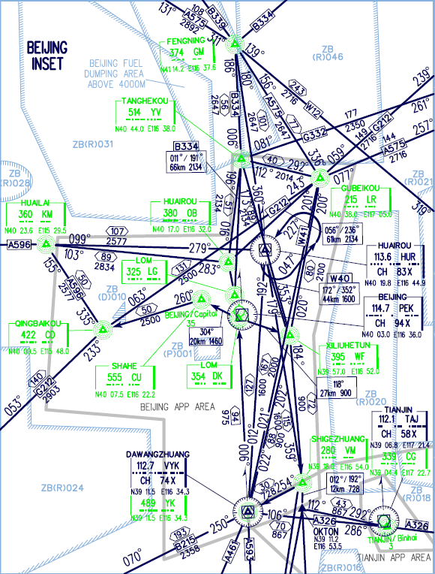
Airspace reservations and restrictions
Reservations
Special Use Airspace
Prohibited Area
Restricted Area
Danger Area
Notes:
1.禁飞区
2.管制区
3.危险区

Slide 4
Classification of Airspace
The purpose of airspace classification
Different degree of control for different activities
Different rules for different activities
Different service for different activities
Different equipage requirements for different activities
Notes:
1.对不同活动进行分级控制
2.对不同活动采取不同的规则
3.对不同的活动提供不同的服务
4.对不同的活动提供不同的机组人员

Slide 5

Airspace for Commercial Flights
Airways and Air-routes (AWY)
Terminal Control Areas (TMA)
Aerodrome Control Zones (CTZ)
AWY
AWY
TMA
Uncontrolled Airspace
TMA
CTZ
CTZ
Notes:
1.TMA终端管制区，负责几个机场的管制

Slide 6
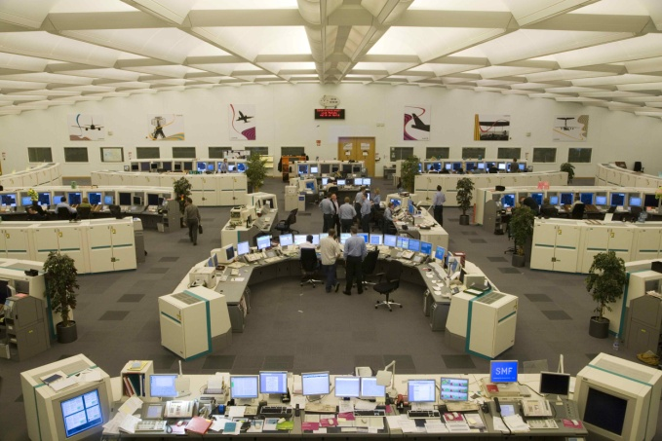
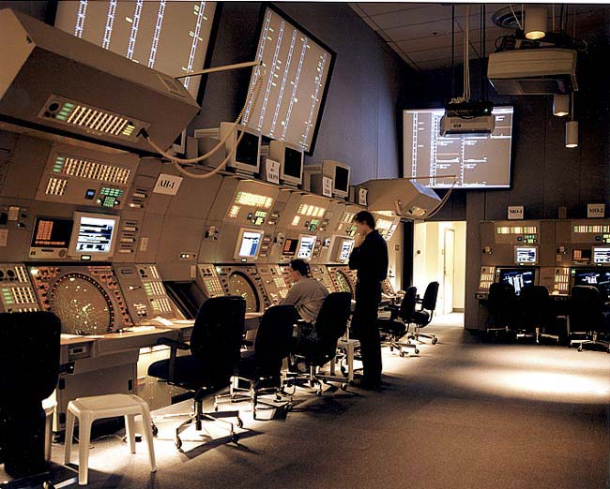
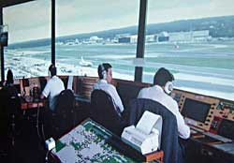
Air Traffic Control Units
Airways and Air-routes ----- Area/Airway Control Centre
Terminal Control Areas ----- Terminal/Approach Control
Aerodrome Control Zone ----- Tower control

Slide 7
China Airspace Classification
Classification of Chinese airspace
A – High level airspace
B – Medium and low level airspace
C –Terminal (Approach) control area
D – tower control zone
Unclassified in fact!
All airspace is controlled due to historical reasons

